Slide 1

How to create an expungement application
AKA: Where the heck do I begin?
Judge Michelle Rick MI COA

Slide 2
Client interview
Confirm full name, including any aliases
Obtain DOB
Verify current & former addresses
Reconstruct client's understanding of past criminal contacts resulting in a criminal charge, including convictions, dismissals, set-asides, and deferrals. Are any result of being HT victim?
Determine if client has any charges pending.

Slide 3

Trust, but verify
Run an ICHAT (Internet Criminal History Access Tool)
https://apps.michigan.gov/

Slide 4
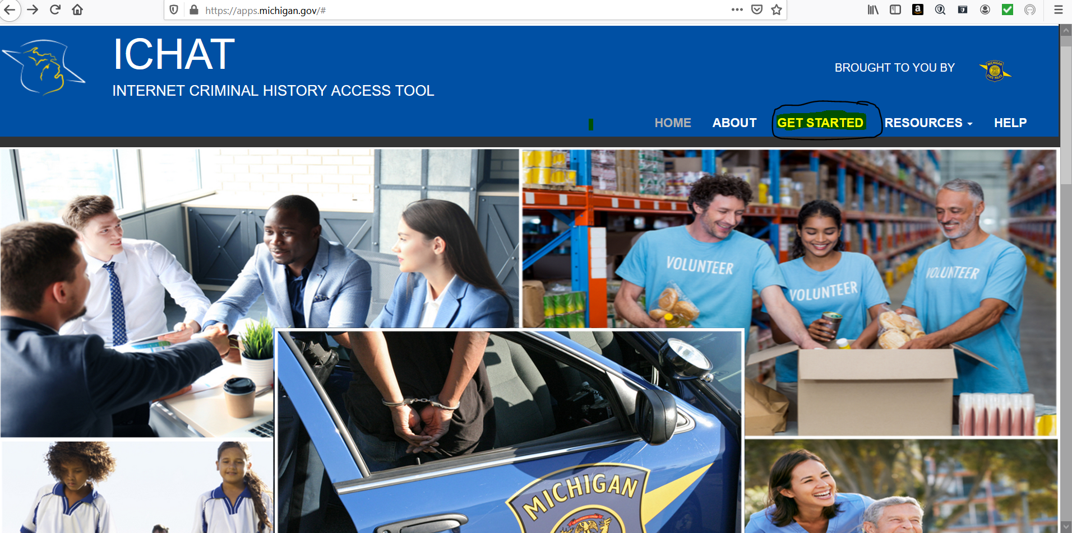

Slide 5
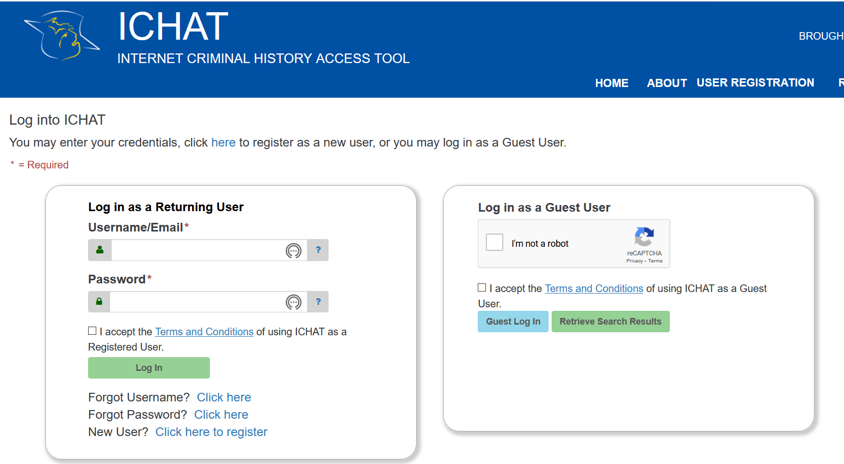

Slide 6
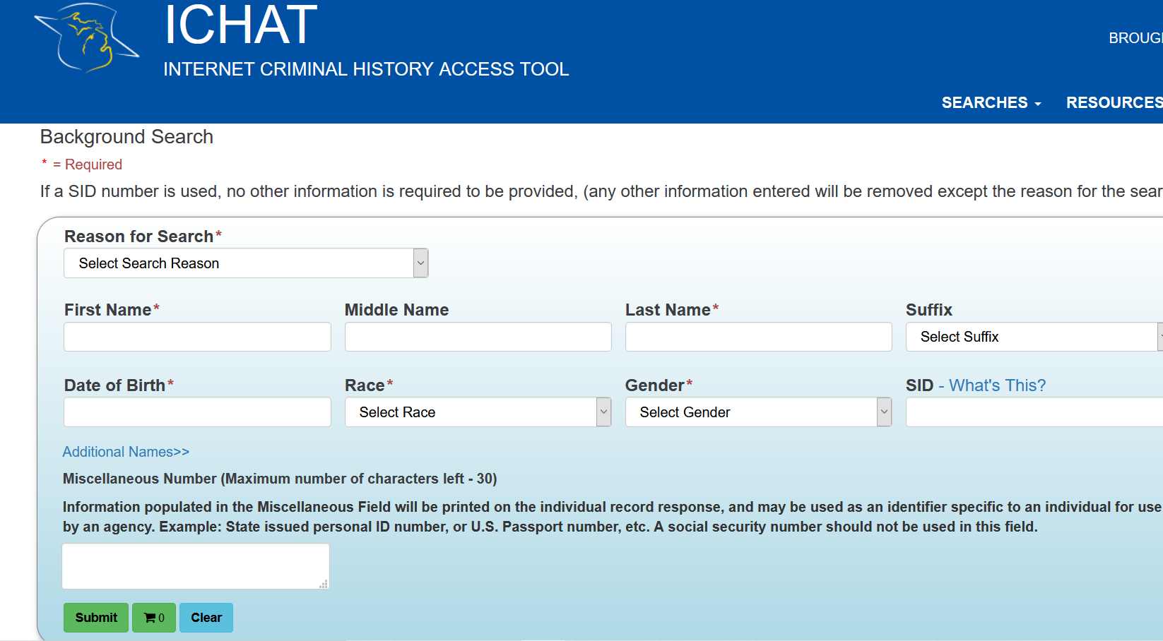

Slide 7
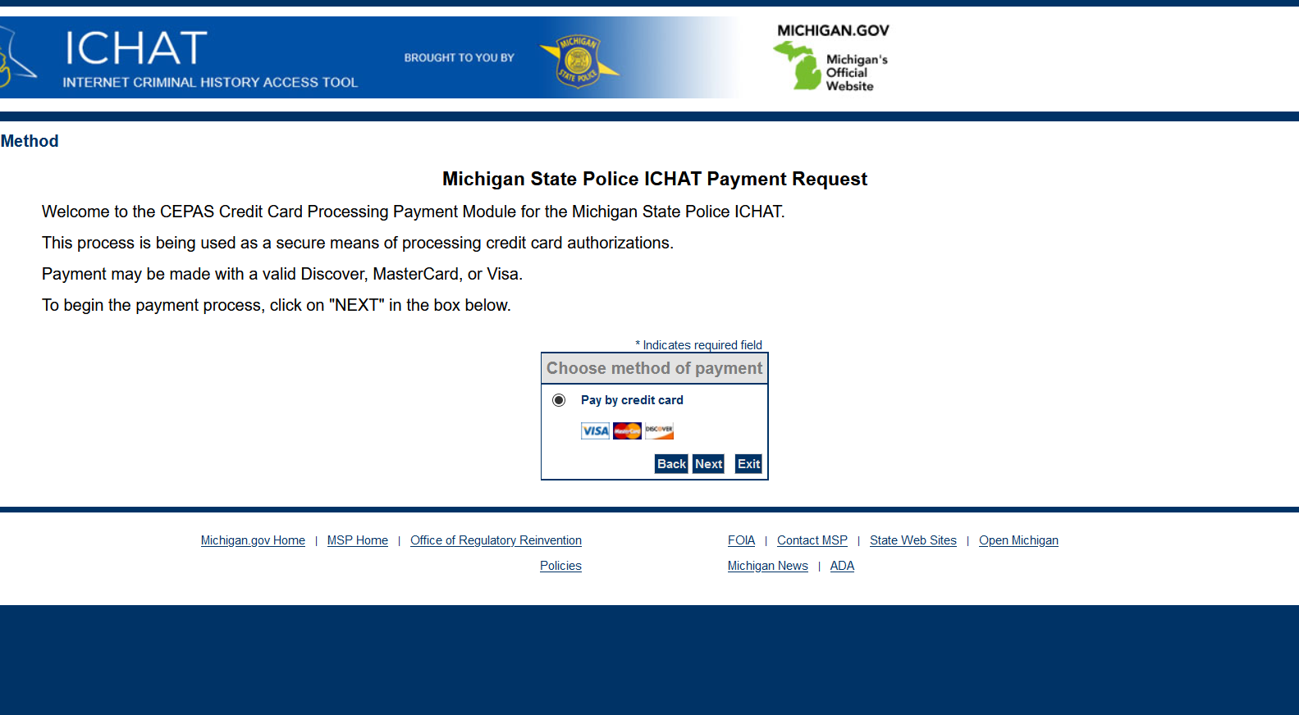

Slide 8
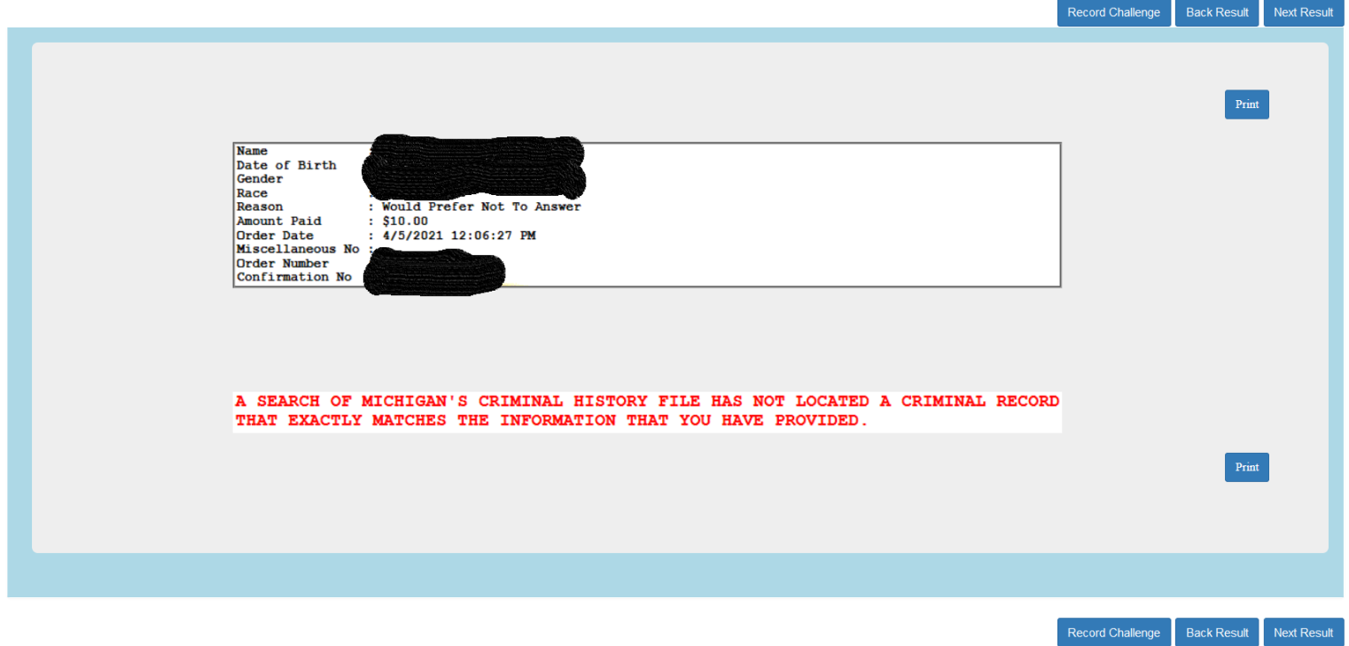

Slide 9
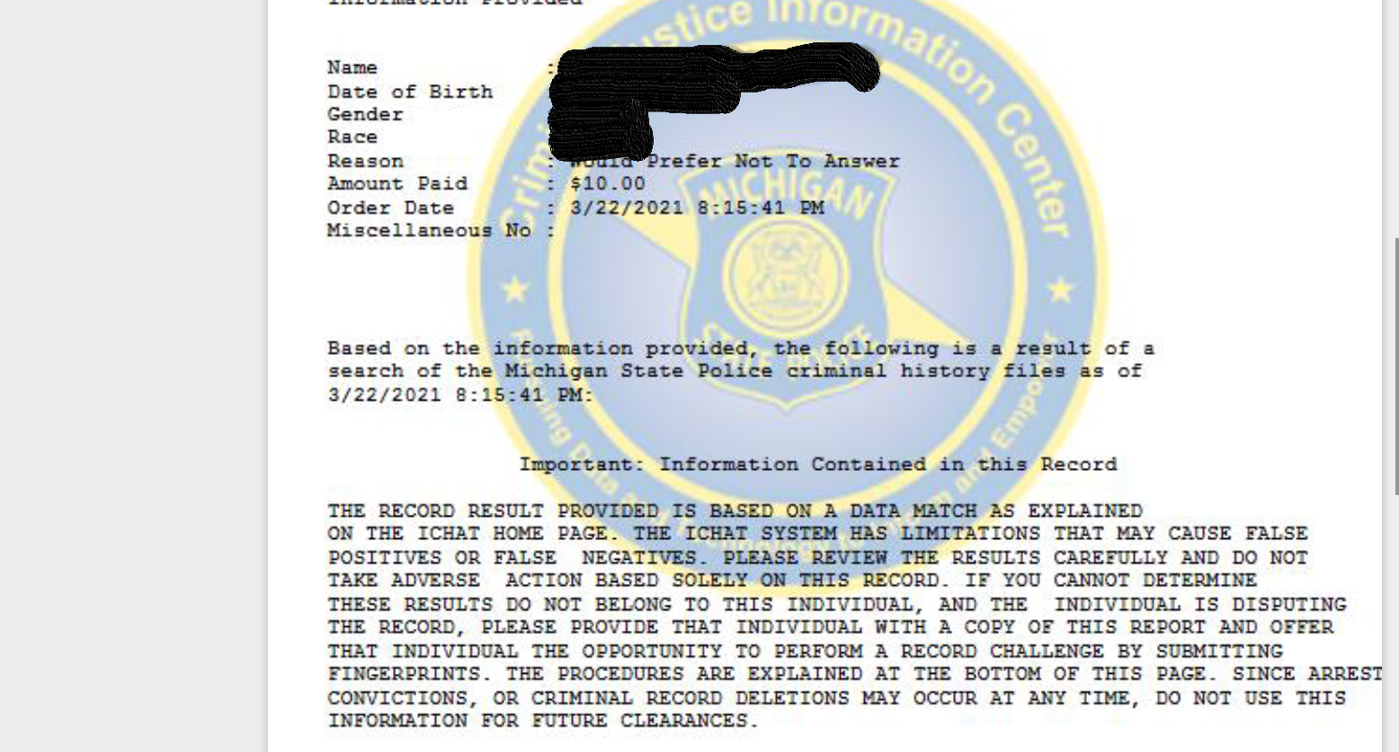

Slide 10
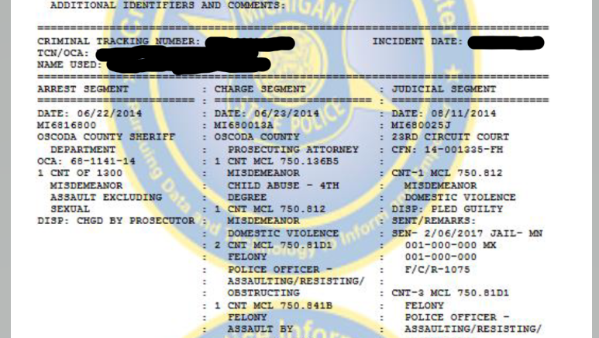

Slide 11
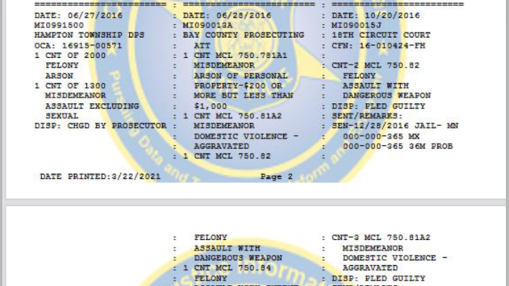

Slide 12
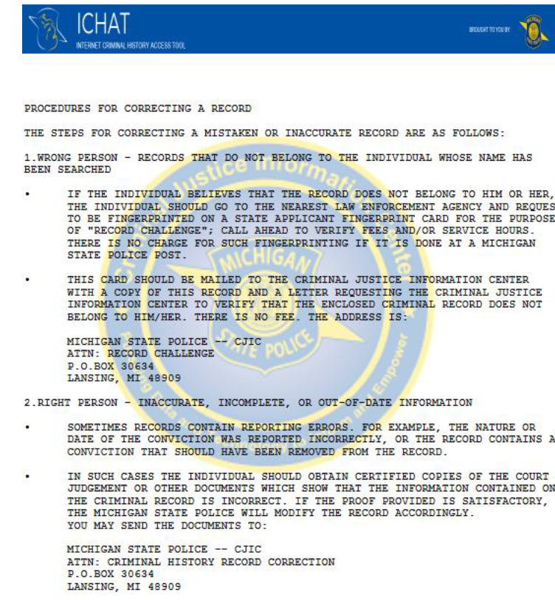

Slide 13
Assuming eligibility, what application do you file on behalf of client
Multiple felonies? (SCAO form 277)
One bad night conduct? (SCAO form 277)
A mix of felonies & misdemeanors? (SCAO form 277)
Marijuana misdemeanors only? (SCAO form 277a)
Human Trafficking Victim? (SCAO form 277b)

Slide 14
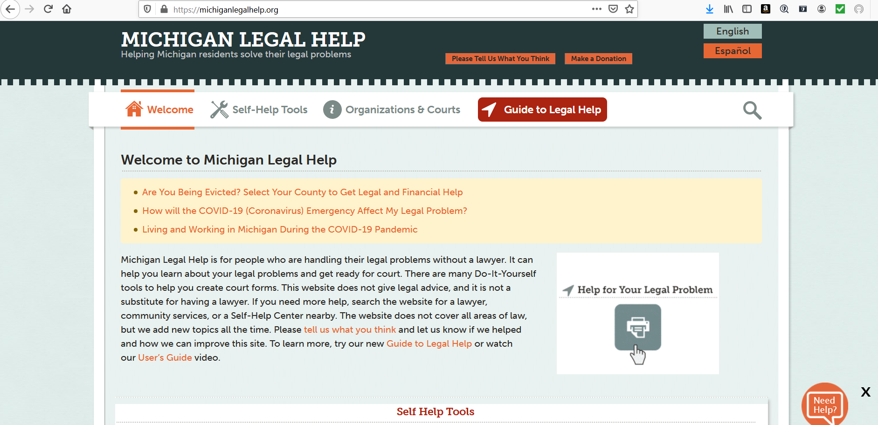
Michigan Legal Help

Slide 15
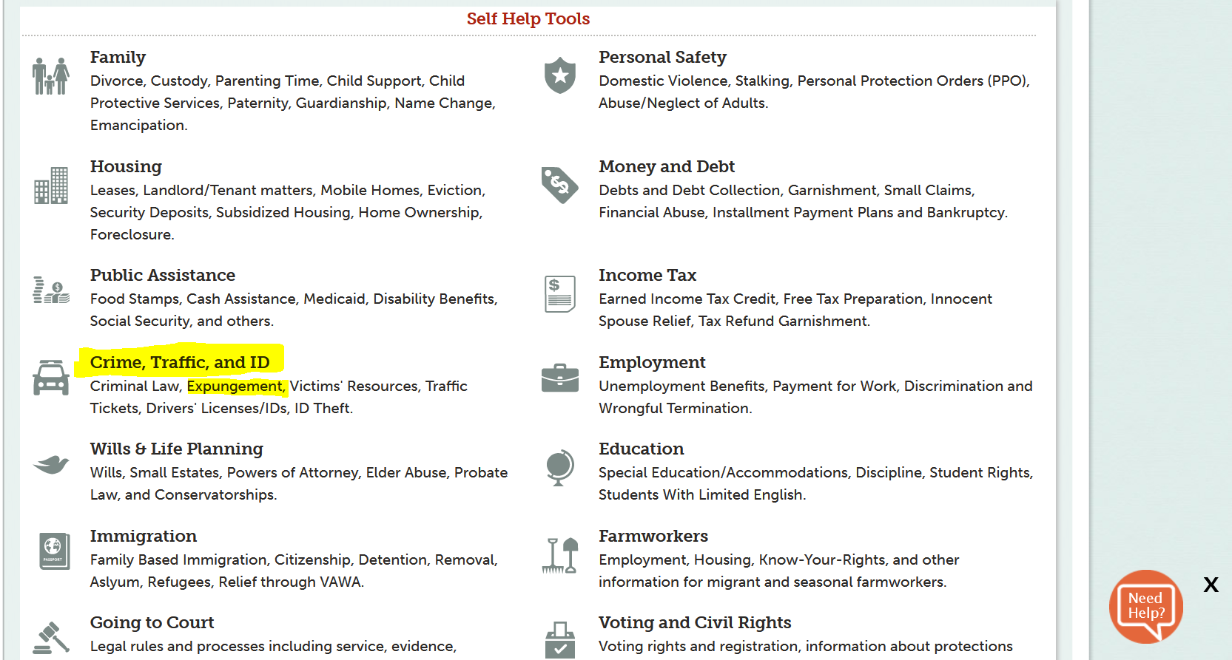

Slide 16
Q: Where is the application filed?
A: Each court where convictions ocurred.
Oscoda County:
      1. 5 copies of the completed application (signature notarized)
      2. 5 copies of Certified Conviction
      3. Letters of community support**
      4. Secure NOH
      Also stop by local police dept to get finger prints on RI-008 form.
Bay County
      1. 5 copies of the completed application (signature notarized)
      2. 5 copies of Certified Conviction
      3. Letters of community support**
      4. Secure NOH
      Also stop by local police dept to get finger prints on RI-008 form

Slide 17
Service of completed application & attachments on interested entities
Michigan State Police: Mail a copy of the application packet, application fee ($50), and the fingerprint card to the Michigan State Police by first- class mail to Michigan State Police, Criminal Justice Information Center - Criminal History, PO Box 30266, Lansing, Michigan 48909
Local county prosecutor by first class mail (See www.michiganprosecutor.org/about-us-menu/prosecutor-directory for the addresses of county prosecutors.)
Attorney General of the State of Michigan by first-class mail to Office of the Attorney General, Criminal Trials and Appeals Division, PO Box 30212, Lansing, Michigan 48909.

Slide 18
Preparing your client for the Court Hearing (with or without you)
1. Be on time.
2. Dress properly.
3. Even if remote, it is a Court hearing. No eating, drinking, smoking, checking one's phone, going through drive-thru...
4. Your client should be prepared to testify. They must be ready to convince the judge why they are entitled to an expungement.
5. Provide the Court with the proposed order (& copies) granting expungement.

Slide 19
